Slide 1



Slide 2
Abstract
Presenting a prototype implementation of an Android-Powered web server for autonomous capture and delivery of sensory informations from mobile devices to remote users.

Slide 3
Introduction
User-generated content on the Internet.
BOINC=Berkeley Open Infastructure for Network Computing
Benefits for contributing with user-generated content
Amazon mechanical turk(群眾外包(Crowdsourcing))
Notes:
有些系統可能很難用程式寫得出來, 或者需要一些人類的智慧才做得到. Amazon 便想出這樣的方式, 讓你把需要人類智慧的複雜工作, 切成小塊, 然後外包給別人處理, 讓一些不認識的人, 可以透過這個平台幫你完成. 這便是Mechanical Turk 極致發揮.

Slide 4
Introduction(cont.)
Apply the concept of volunteer-based computing to build an infastructure for environment sensing.
A lot of underutilized sensory equipment available in existing and emerging wearable devices.
These devices are equipped with a set of embedded sensors.
Notes:
underutilized 未被充分利用
emerging 新興出來的

Slide 5
Introduction(cont.)
Once started, the web server autonomously reads informations from device sensors and delivers them to the connected clients.
Since different types of client applications require different rates of delivery of sensory information, the web server supports two modes of operations.
HTTP standard protocol
Websocket protocol(establish a permanent communication channel)

Slide 6
Related Work
NanoHttpd
  The web server we present in this paper is integrated with Android sensor framework with strong focus on a modular architecture that enables easy extension of the server with support for new types of sensors.
Jetty
I-Jetty(Jetty for Android)
DroidPHP

Slide 7
DEVICE-AGNOSTIC SENSOR SERVERARCHITECTURE
Independent of the number and types of hardware sensors available on a specific device
Operating with all available sensors from any existing and future device, without the need to customize the internal server organization to any specific device
Minimal set of functionalities for any type of sensor, even for those that do not exist yet, but will emerge with new types of devices
Full set of functionalities for the selected types of sensors

Slide 8
Integration of
Android Sensor Framework and the
Web Server
SensorManager
Sensor Android sensor API
SensorEventListener

Slide 9
Integration of
Android Sensor Framework and the
Web Server(cont.)
Using the SensorManager class, application developer registers a sensor-specific listener with a selected type of sensor.
Sensor-specific listener implements the SensorEventListener interface to be able to receive notifications when sensor state changes.
Custom sensor listener
The web server then uses the getReport() method to read the latest sensor readings and sends the data to the remote client.
Default sensor listener.

Slide 10
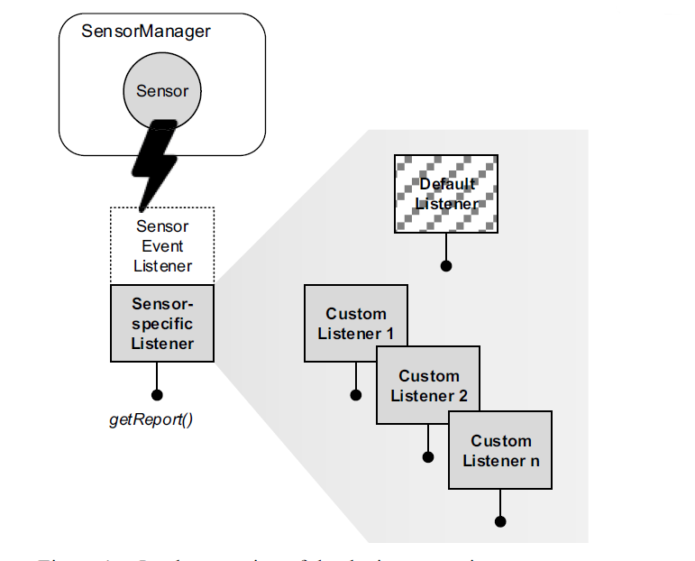
Integration of
Android Sensor Framework and the
Web Server(cont.)

Slide 11
SELF-CONFIGURABLE WEB SERVER FOR ANDROID
SENSOR FRAMEWORK
Sensor Discovery and Listener Setup
  Initialization of the web server begins with sensor discovery.
  Using the SensorManager to retrieve the list of available sensors on a device it is running on.
  To register a listener with each sensor
  searches through the pool of sensor listeners to check if there is any sensor-specific listener assigned to the given type of sensor
  At the end of this procedure, associated listener with public getReport() method exposed through which the web server retrieves the sensor data when clients ask for them.

Slide 12
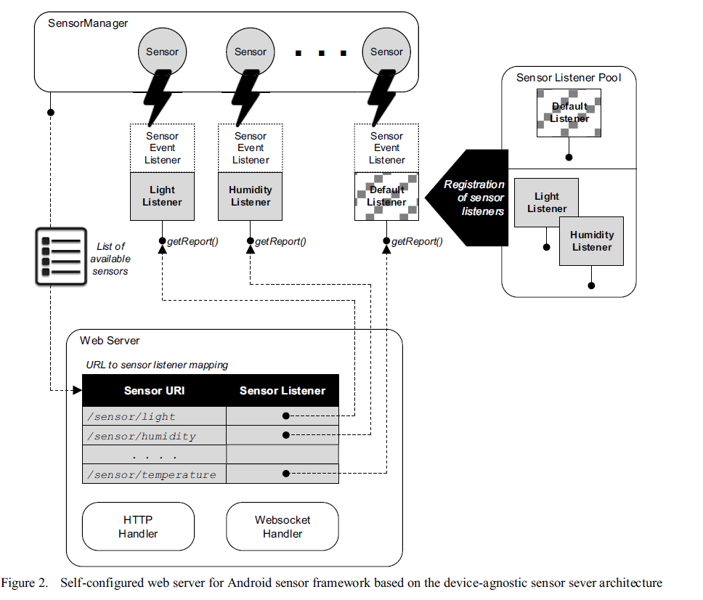
SELF-CONFIGURABLE WEB SERVER FOR ANDROID
SENSOR FRAMEWORK(cont.)

Slide 13
SELF-CONFIGURABLE WEB SERVER FOR ANDROID
SENSOR FRAMEWORK(cont.)
URI Scheme Construction
  Through a REST interface. Each sensor needs to be associated with a URI through which remote clients can access sensor data.
  the URI scheme is also different on different devices.
  For particular device, the URI scheme is generated dynamically during the web server startup based on the list of available sensors retrieved from SensorManager.
  Particular sensor in sensor list, the web server constructs a URI for each sensor and maps the URI to the instance of the sensor listener registered with that type of sensor during the sensor discovery phase.

Slide 14
SELF-CONFIGURABLE WEB SERVER FOR ANDROID
SENSOR FRAMEWORK(cont.)
Dual Protocol Support
  Formatting into HTML snippets.
  Responses are generated using HTML templates.
  HTML is chosen as a default format in order to be easily displayed in clients’ web browsers.
  Applications that do not require frequent updates of sensor state.
  Temperature or atmospheric pressure.
  Gathering GPS coordinates to calculate speed or routes.
  using HTTP protocol makes communication inefficient due to the fact that each update requires new HTTP request-response cycle.

Slide 15
WEB SERVER UPGRADES TO SUPPORT NEW TYPES OF SENSORS
Using the Websocket protocol, a permanent network connection is established between the client and the server.
Websocket-based communication enables near real-time updates of sensory data in client applications.
Network-efficient.
Saves device’s battery life.

Slide 16
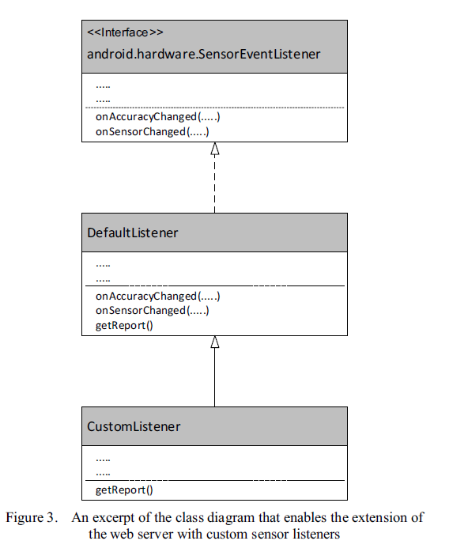
WEB SERVER UPGRADES TO SUPPORT NEW TYPES OF SENSORS

Slide 17
WEB SERVER UPGRADES TO SUPPORT NEW TYPES OF SENSORS(cont.)
DefaultListener allows the developer to redefine the raw sensor data handling and formatting by overriding the getReport() method.

Slide 18
CONLUSION
To make sensor data available for remote access, we present an implementation of a web server for execution on Android-powered mobile devices.
The purpose of the web server is to operate as a component of a volunteer-based environment sensing.
Individual sensor is exposed to clients through REST API via HTTP and Websocket protocol.
Long-running operations in the background.
Modular web server architecture that enables dynamic creation of URI scheme based on the available set of sensors.

